Slide 1
THE LIFE OF CHRIST
PART 48

Slide 2
Matthew 17, Mark 9, Luke 9, and 2 Peter 1:17-18

Slide 3
Luke 9:28 Now it came to pass, about eight days after these sayings, that He took Peter, John, and James and went up on the mountain to pray.
Mark 9:2 Now after six days Jesus took Peter, James, and John, and led them up on a high mountain apart by themselves; and He was transfigured before them.

Slide 4
Luke 9:29 As He prayed, the appearance of His face was altered, and His robe became white and glistening.

Slide 5
Mark 9:3 His clothes became shining, exceedingly white, like snow, such as no launderer on earth can whiten them.
Matthew 17:2 … His face shone like the sun, and His clothes became as white as the light.

Slide 6
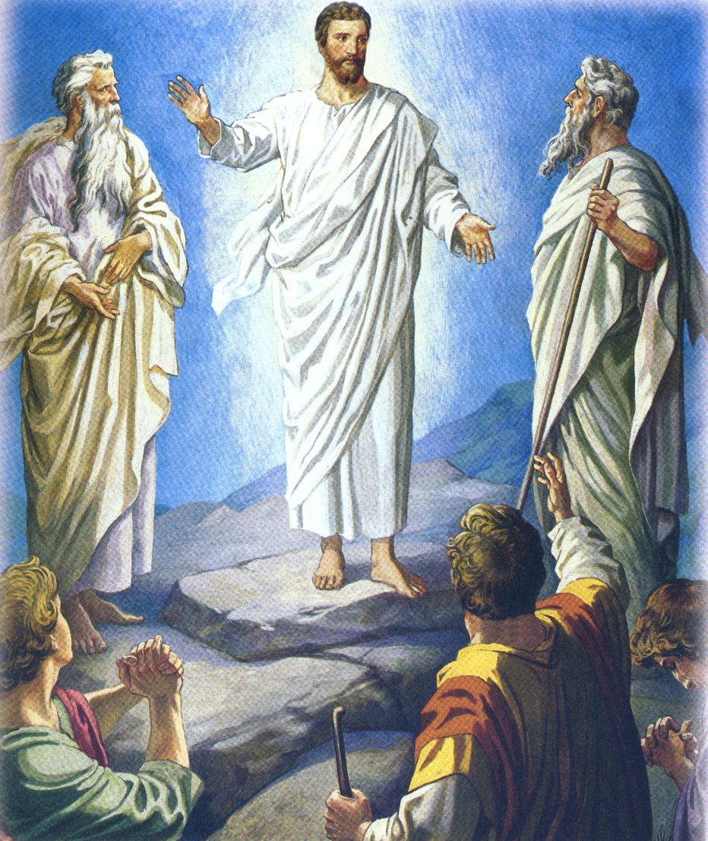
Luke 9:30 And behold, two men talked with Him, who were Moses and Elijah, ³¹ who appeared in glory and spoke of His decease which He was about to accomplish at Jerusalem.

Slide 7
Hebrews 9:22 And according to the law almost all things are purified with blood, and without shedding of blood there is no remission. ²³ Therefore it was necessary that the copies of the things in the heavens should be purified with these, but the heavenly things themselves with better sacrifices than these. ²⁴ For Christ has not entered the holy places made with hands, which are copies of the true, but into heaven itself, now to appear in the presence of God for us; ²⁵ not that He should offer Himself often, as the high priest enters the Most Holy Place every year with blood of another -- ²⁶ He then would have had to suffer often since the foundation of the world; but now, once at the end of the ages, He has appeared to put away sin by the sacrifice of Himself.

Slide 8
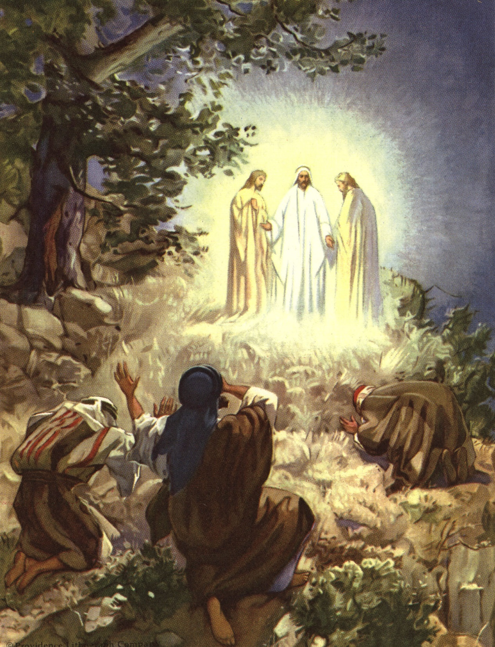
Luke 9:32 But Peter and those with him were heavy with sleep; and when they were fully awake, they saw His glory and the two men who stood with Him.

Slide 9
Luke 9:33 Then it happened, as they were parting from Him, that Peter said to Jesus, "Master, it is good for us to be here; and let us make three tabernacles: one for You, one for Moses, and one for Elijah" -- not knowing what he said.
Mark 9:6 because he did not know what to say, for they were greatly afraid.

Slide 10
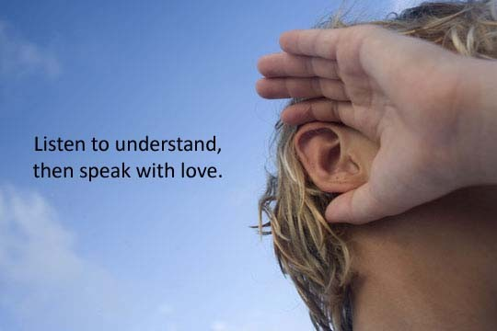
James 1:19 So then, my beloved brethren, let every man be swift to hear, slow to speak, slow to wrath;

Slide 11
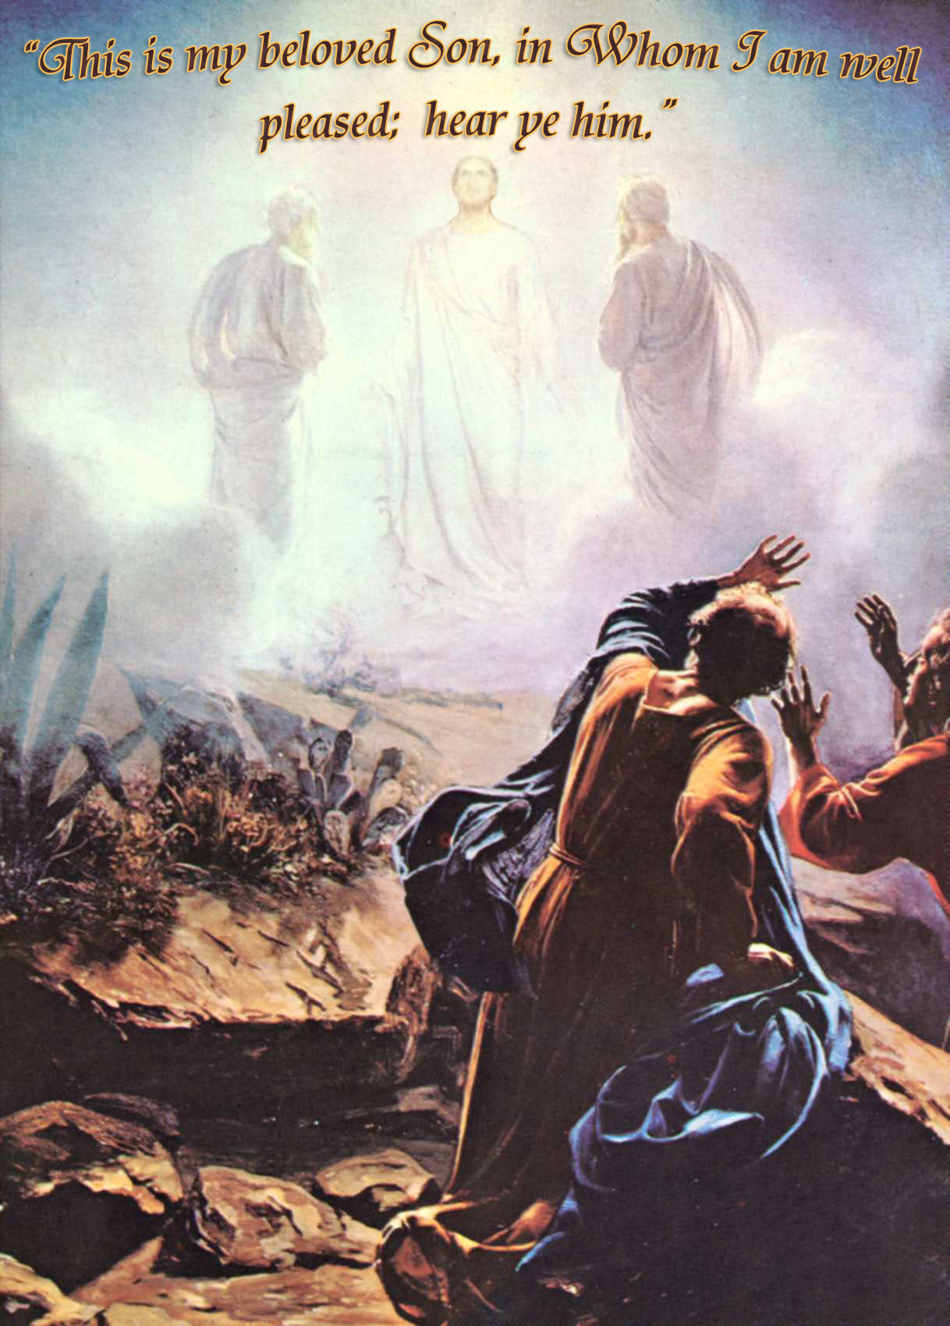
Luke 9:34 While he was saying this, a cloud came and overshadowed them; and they were fearful as they entered the cloud. ³⁵ And a voice came out of the cloud, saying, "This is My beloved Son. Hear Him!"

Slide 12
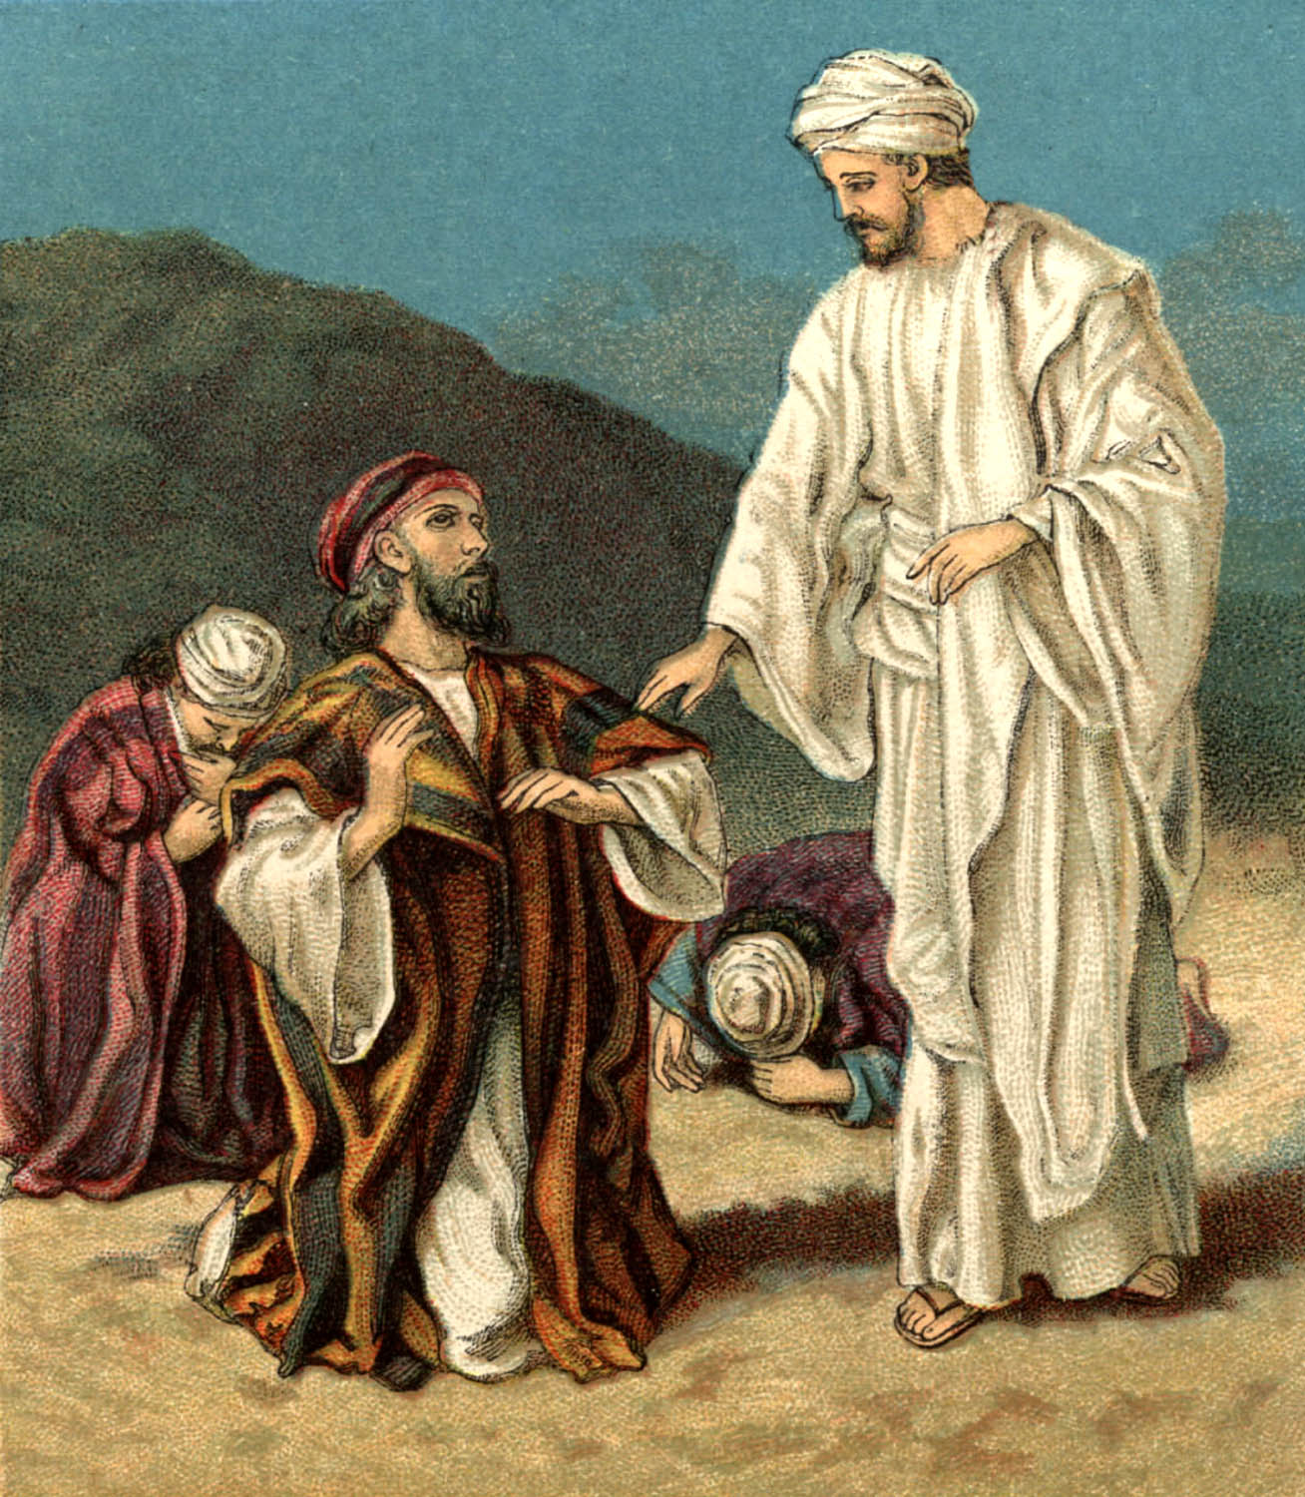
Matthew 17:6 And when the disciples heard it, they fell on their faces and were greatly afraid. ⁷ But Jesus came and touched them and said, "Arise, and do not be afraid." ⁸ When they had lifted up their eyes, they saw no one but Jesus only.

Slide 13
Ephesians 2:14 For He Himself is our peace, who has made both one, and has broken down the middle wall of separation, ¹⁵ having abolished in His flesh the enmity, that is, the law of commandments contained in ordinances, so as to create in Himself one new man from the two, thus making peace, ¹⁶ and that He might reconcile them both to God in one body through the cross, thereby putting to death the enmity.

Slide 14
Colossians 2:14 having wiped out the handwriting of requirements that was against us, which was contrary to us. And He has taken it out of the way, having nailed it to the cross.

Slide 15
Mark 9:9 Now as they came down from the mountain, He commanded them that they should tell no one the things they had seen, till the Son of Man had risen from the dead. ¹⁰ So they kept this word to themselves, questioning what the rising from the dead meant.

Slide 16
Matthew 17:10 And His disciples asked Him, saying, "Why then do the scribes say that Elijah must come first?" ¹¹ Jesus answered and said to them, "Indeed, Elijah is coming first and will restore all things. ¹² "But I say to you that Elijah has come already, and they did not know him but did to him whatever they wished. Likewise the Son of Man is also about to suffer at their hands." ¹³ Then the disciples understood that He spoke to them of John the Baptist.

Slide 17
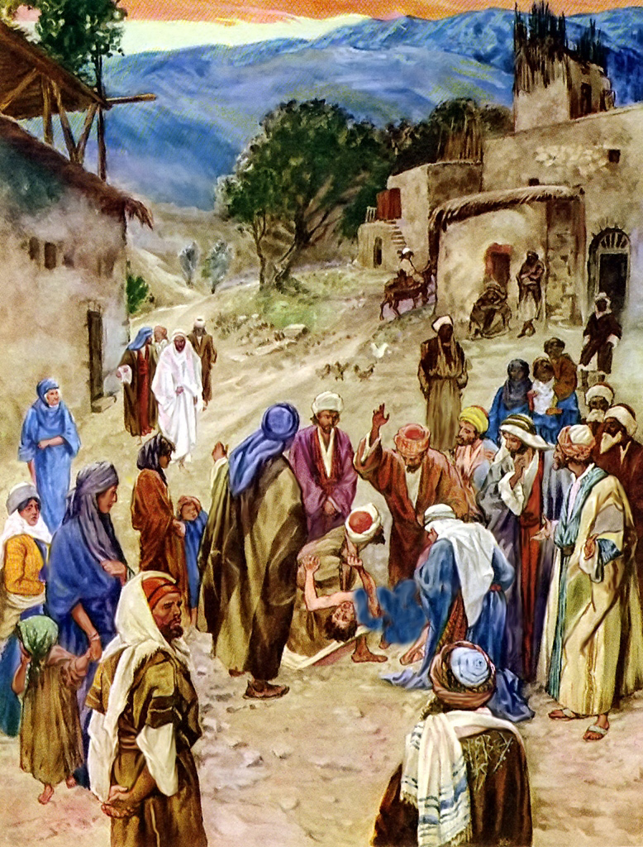
Mark 9:14 And when He came to the disciples, He saw a great multitude around them, and scribes disputing with them. ¹⁵ Immediately, when they saw Him, all the people were greatly amazed, and running to Him, greeted Him. ¹⁶ And He asked the scribes, "What are you discussing with them?"

Slide 18
Mark 9:17 Then one of the crowd answered and said, "Teacher, I brought You my son, who has a mute spirit. ¹⁸ "And wherever it seizes him, it throws him down; he foams at the mouth, gnashes his teeth, and becomes rigid. So I spoke to Your disciples, that they should cast it out, but they could not."

Slide 19
Matthew 17:14 a man came to Him, kneeling down to Him and saying, ¹⁵ "Lord, have mercy on my son, for he is an epileptic and suffers severely; for he often falls into the fire and often into the water.

Slide 20
Luke 9:38 "Teacher, I implore You, look on my son, for he is my only child. ³⁹ "And behold, a spirit seizes him, and he suddenly cries out; it convulses him so that he foams at the mouth, and it departs from him with great difficulty, bruising him.

Slide 21
Mark 9:19 He answered him and said, "O faithless generation, how long shall I be with you? How long shall I bear with you? Bring him to Me."

Slide 22
Mark 9:20 Then they brought him to Him. And when he saw Him, immediately the spirit convulsed him, and he fell on the ground and wallowed, foaming at the mouth. ²¹ So He asked his father, "How long has this been happening to him?" And he said, "From childhood. ²² "And often he has thrown him both into the fire and into the water to destroy him. But if You can do anything, have compassion on us and help us." ²³ Jesus said to him, "If you can believe, all things are possible to him who believes." ²⁴ Immediately the father of the child cried out and said with tears, "Lord, I believe; help my unbelief

Slide 23
Mark 9:25 When Jesus saw that the people came running together, He rebuked the unclean spirit, saying to it, "Deaf and dumb spirit, I command you, come out of him and enter him no more!" ²⁶ Then the spirit cried out, convulsed him greatly, and came out of him. And he became as one dead, so that many said, "He is dead." ²⁷ But Jesus took him by the hand and lifted him up, and he arose.

Slide 24
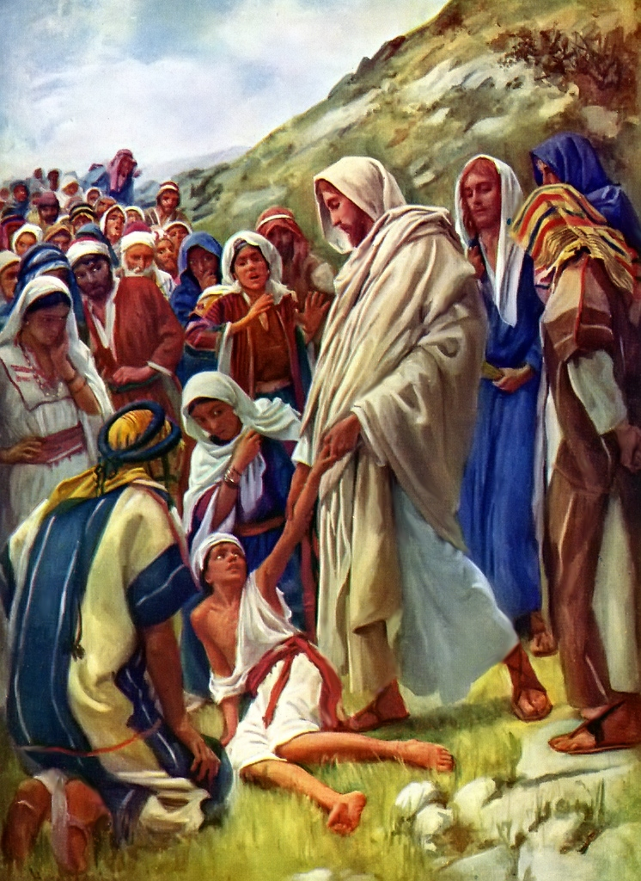

Slide 25
Luke 9:43 And they were all amazed at the majesty of God. But while everyone marveled at all the things which Jesus did, He said to His disciples, ⁴⁴ "Let these words sink down into your ears, for the Son of Man is about to be betrayed into the hands of men." ⁴⁵ But they did not understand this saying, and it was hidden from them so that they did not perceive it; and they were afraid to ask Him about this saying.

Slide 26
Matthew 17:23 "and they will kill Him, and the third day He will be raised up." And they were exceedingly sorrowful.

Slide 27
Mark 9:28 And when He had come into the house, His disciples asked Him privately, "Why could we not cast it out?" ²⁹ So He said to them, "This kind can come out by nothing but prayer and fasting."

Slide 28
Matthew 17:20 So Jesus said to them, "Because of your unbelief; for assuredly, I say to you, if you have faith as a mustard seed, you will say to this mountain, 'Move from here to there,' and it will move; and nothing will be impossible for you. ²¹ "However, this kind does not go out except by prayer and fasting."

Slide 29
Mark 9:30 Then they departed from there and passed through Galilee, and He did not want anyone to know it.

Slide 30
Matthew 17:24 When they had come to Capernaum, those who received the temple tax came to Peter and said, "Does your Teacher not pay the temple tax?" ²⁵ He said, "Yes." And when he had come into the house, Jesus anticipated him, saying, "What do you think, Simon? From whom do the kings of the earth take customs or taxes, from their sons or from strangers?" ²⁶ Peter said to Him, "From strangers." Jesus said to him, "Then the sons are free. ²⁷ "Nevertheless, lest we offend them, go to the sea, cast in a hook, and take the fish that comes up first. And when you have opened its mouth, you will find a piece of money; take that and give it to them for Me and you."

Slide 31
This half-shekel was a Jewish poll tax levied annually for the support of the temple, a tax which Jesus perhaps had paid often in the past; but the appearance of the solicitors with an inquiry placed a different face on things. IF Christ paid the tax, it would mean, in a sense, that he was laying claim to no special dignity but was accepting the status of an ordinary Jew, rabbis being exempt. To be sure, Jesus might have claimed exemption as a Jewish rabbi, or teacher; but to have done so would have compromised his higher claim to be the Messiah, which claim was widely known, though disputed by his enemies.

Slide 32
A refusal to pay it would have involved him as a technical lawbreaker; and it is likely that the dilemma involved in these various facets of the problem was what prompted the inquiry in the first place. The poll tax was generally left to voluntary compliance; for centuries no enforcement structure existed and no penalties for default were prescribed or enforced. However, about the time of Christ, regulations had been posted, with mild penalties; but these were rarely enforced. (Coffman Commentary).

Slide 33
